Slide 1

Industrial Machine Learning on Hadoop and Spark
Maks Nakhodnov, Bremen 2025

Slide 2
Distributed computing. MapReduce. YARN
Plan:
How to process big data?
Hadoop Streaming
Word Count Example
MapReduce v1.0, YARN

Slide 3
MapReduce. Hadoop Streaming
Hadoop MapReduce has native implementations for:
- Java, C++, Scala
No Python API
Hadoop Streaming — a wrapper for the Java API for Python code
Downside: purely textual data transfer

Slide 4
MapReduce. Hadoop Streaming
Mapper, Reducer, … receive the input from stdin and write to stdout
Mapper processes input line-by-line and writes the output KV pair, separating using <TAB>
Reducer receives sorted by key KV pairs (instead of the values list)
Roughly equal to: $cat input | python map.py | sort | python reduce.py
All of the 9 parts of the MapReduce workflow can be adjusted using command-line keys
https://hadoop.apache.org/docs/r1.2.1/streaming.html

Slide 5
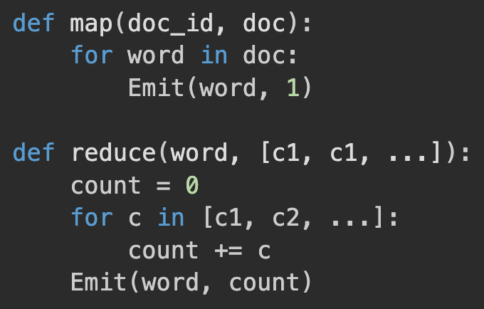
MapReduce. Word Count I
Count the number of occurrences of each word in the text corpus:
The simplest implementation: The problem is that too much data is being transferred between the map and reduce phases.

Slide 6
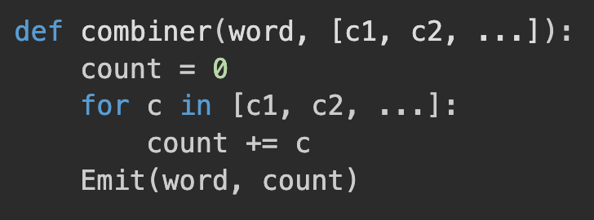
MapReduce. Word Count II. Combiner
Count the number of occurrences of each word in the text corpus:
The Combiner function is optional and can be used to optimize the process by reducing the amount of data transferred between the map and reduce phases:

Slide 7
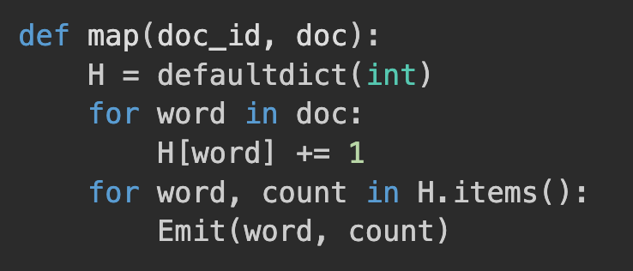
MapReduce. Word Count III. In-mapper combiner
Count the number of occurrences of each word in the text corpus:
The next problem is that the map function is emitting too many intermediate key-value pairs.
We can optimize the map function by using a local aggregation technique:

Slide 8
MapReduce. Word Count III. In-mapper combiner
Count the number of occurrences of each word in the text corpus:
The number of intermediate key-value pairs emitted by the map function (+ the amount of data transferred between the map and reduce phases) is reduced
The local aggregation should not use too much memory
If a document is too large, we may need to flush the local aggregation to the output periodically

Slide 9
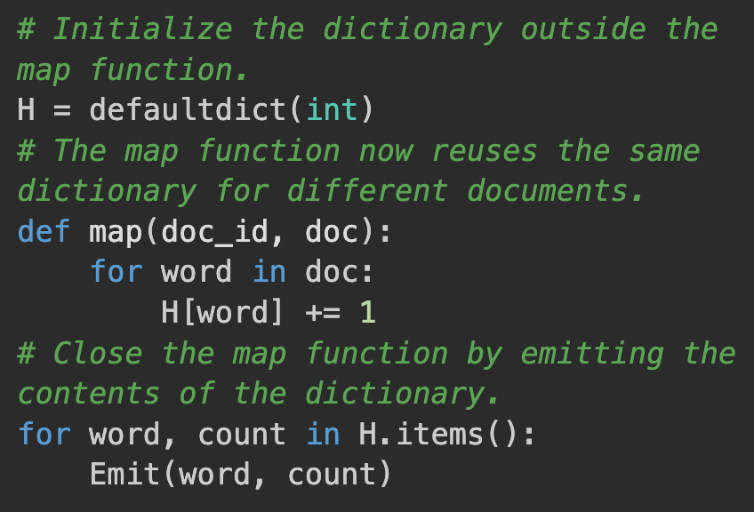
MapReduce. Word Count IV. In-mapper combiner V2
Count the number of occurrences of each word in the text corpus:
If the number of distinct words is small, we can reuse the same dictionary for different documents:
We have to flush the dictionary periodically to avoid OOM
The dictionary can be initialized from local FC to implement tricky behavior (i.e., Map-side join), or be broadcast using --files CLI flag

Slide 10
Hadoop. Resource Management
How many mappers and reducers should be launched, when, and where?
What resources should be allocated for task execution?
How can the execution of the task be monitored?
How should the executable code be delivered to the workers?
How should the task execution process be logged?
What actions should be taken in case of failures?

Slide 11
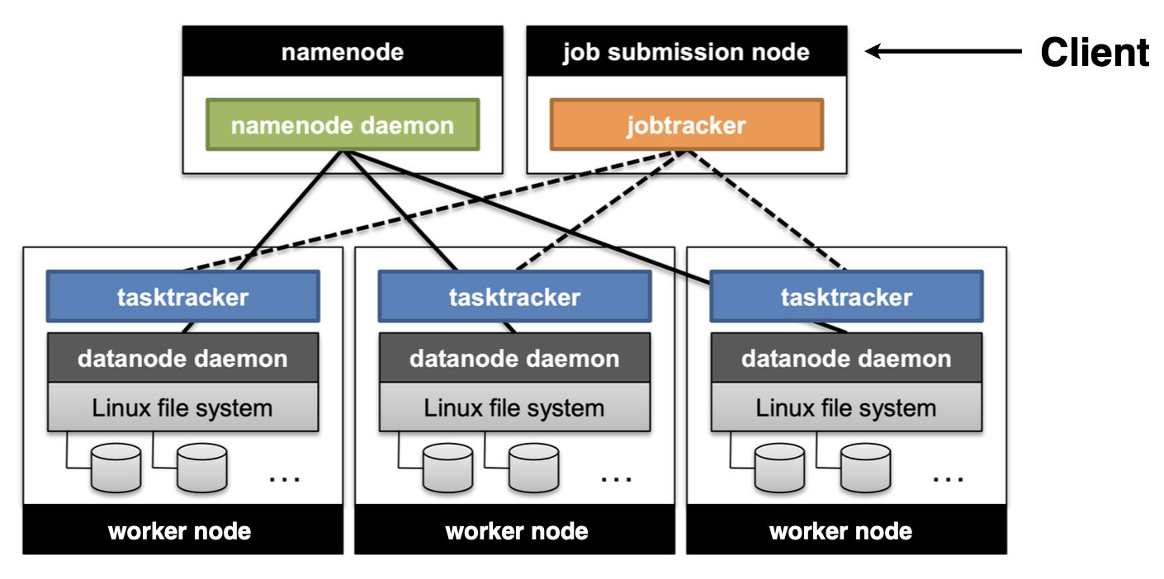
Hadoop. MapReduce V1

Slide 12
Hadoop. MapReduce V1. JobTracker
Manages task execution and determines on which TaskTracker a worker will run
Controls the MapReduce job execution process
Monitors task progress
Restarts failed or slow tasks

Slide 13
Hadoop. MapReduce V1. TaskTracker
Manages all workers on a single server
Receives information from the JobTracker about which worker to run on which data
Sends progress statistics (counters) to the JobTracker
Reports to the JobTracker on successful completion or failure of workers

Slide 14
Hadoop. MapReduce V1. Resource distribution
The main drawback is the rigid resource distribution between the mapper and the reducer nodes
The slots system:
A task runs in one slot
Each TaskTracker has a defined number of slots
Each slot has a defined amount of RAM allocated
Mappers + Reducers = N slots
The distribution can be changed only on the cluster restart
Limited horizontal scaling:
4000 nodes
40000 parallel tasks

Slide 15
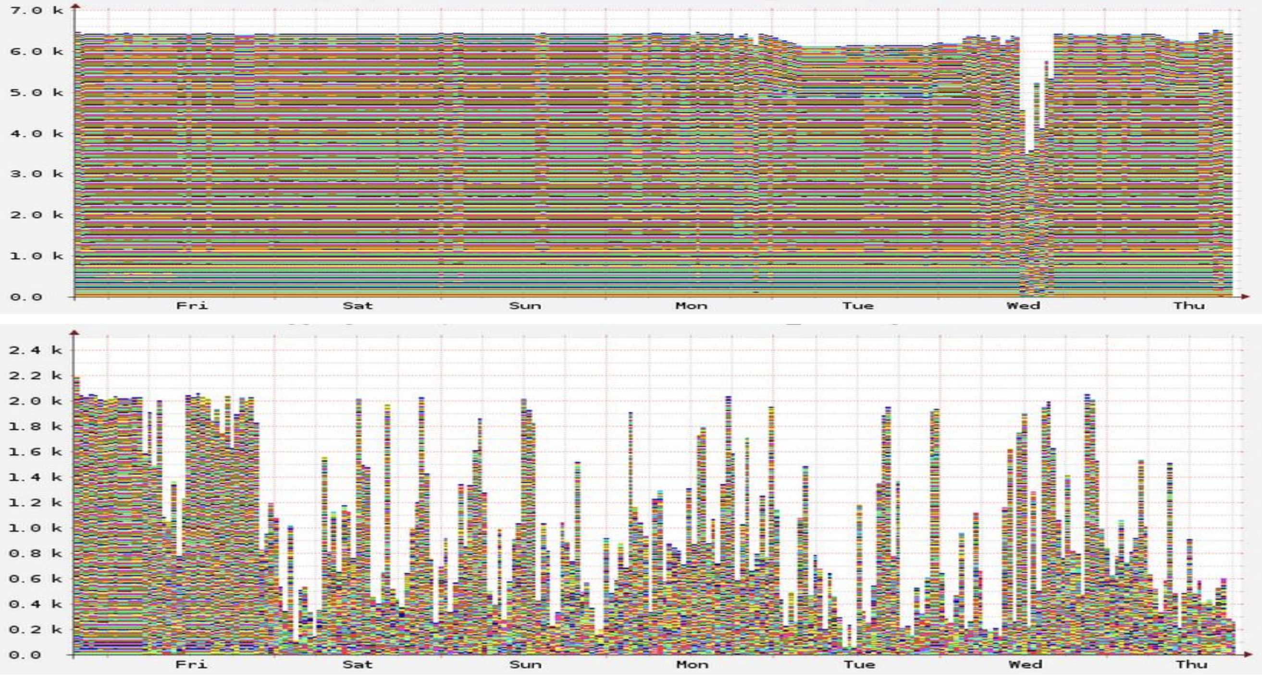
Hadoop. MapReduce V1. Resource distribution

Slide 16
Hadoop. MapReduce V1. Rigid distribution
Example:
10 nodes, 16 cores each
TT requires 1 core
300 mappers, each mapper works for 10 minutes
The single reducer finishes in 100 minutes
How to choose the number of mappers and reducers?

Slide 17
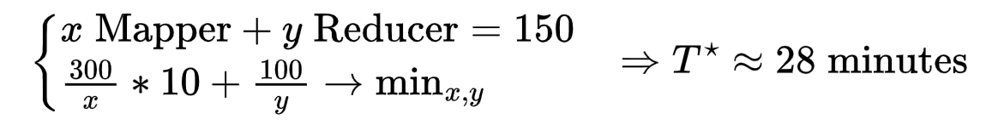
Hadoop. MapReduce V1. Per task distribution
Example:
10 nodes, 16 cores each
TT requires 10 cores
300 mappers, each mapper works for 10 minutes
The single reducer finishes in 100 minutes
How to choose the number of mappers and reducers?

Slide 18
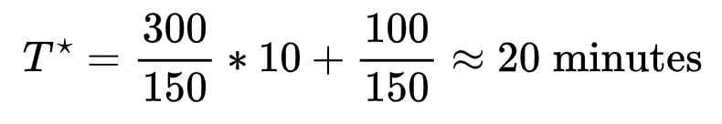
Hadoop. MapReduce V1. No distribution
Example:
10 nodes, 16 cores each
TT requires 10 cores
300 mappers, each mapper works for 10 minutes
The single reducer finishes in 100 minutes
How to choose the number of mappers and reducers?
The solution — YARN

Slide 19
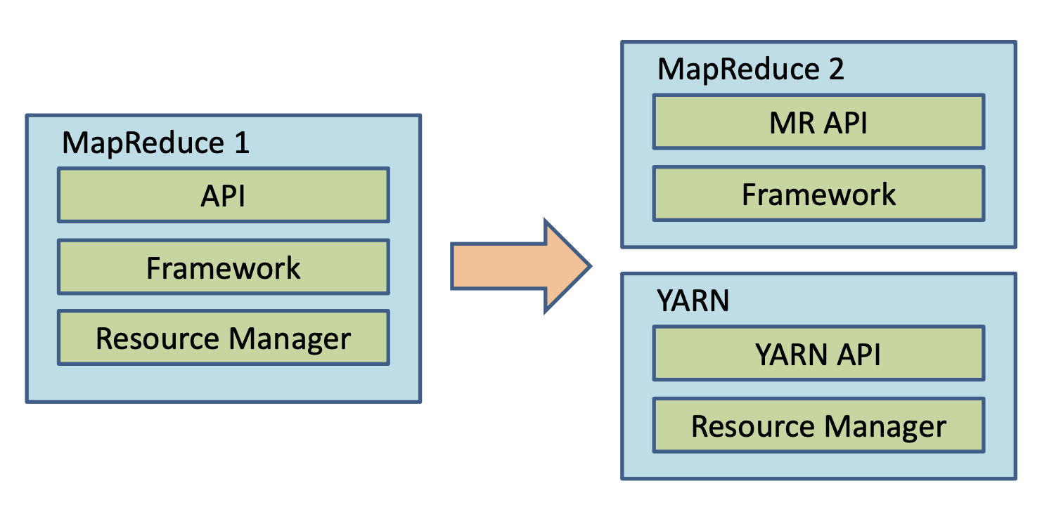
Hadoop. YARN
Takes over resource management functions
Can run different types of tasks (MapReduce is one of the options)

Slide 20
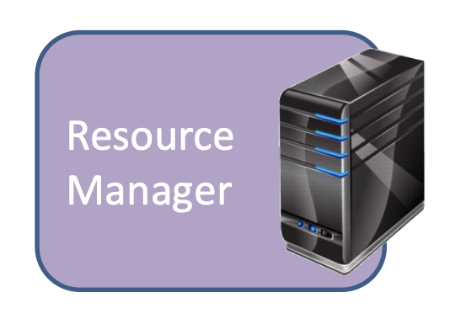
Hadoop. YARN. Resource Manager
Runs on a dedicated server
Manages global resource allocation
Manages nodes
Manages containers
Resolves conflicts between competing applications
Interacts with the ApplicationMaster
Doesn’t know the application type
Responsible for data protection

Slide 21
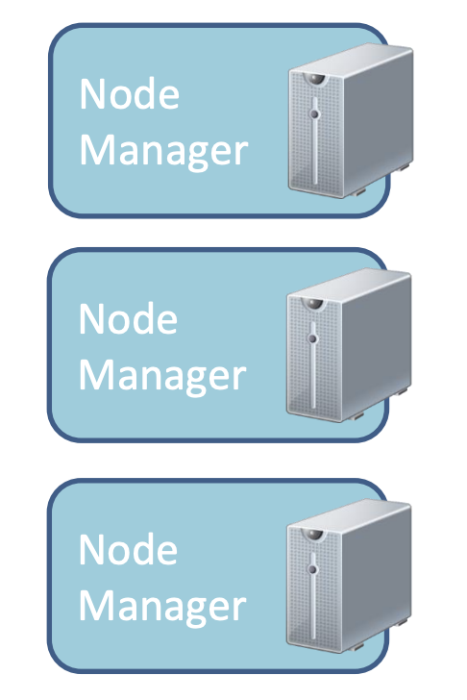
Hadoop. YARN. Node Manager
Runs on all nodes in the cluster
Interacts with the ResourceManager
Manages processes inside containers
Logs application data
Maintains ACL-based security at the node level

Slide 22
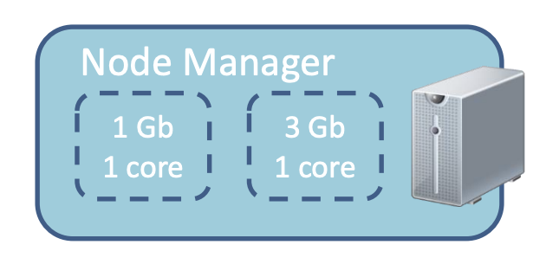
Hadoop. YARN. Containers
Created by RM on demand
Reserves a specific amount of resources on the node (memory, CPU)
Application runs in one or multiple containers

Slide 23
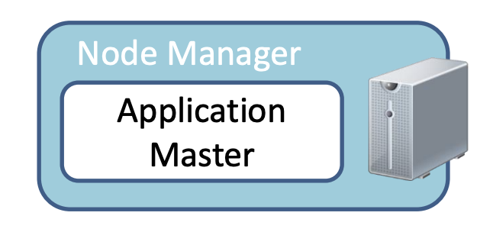
Hadoop. YARN. Application Master
One per application
Depends on the type of task (has a dedicated one for MapReduce jobs)
Runs inside a container
Requests additional containers to execute the application

Slide 24
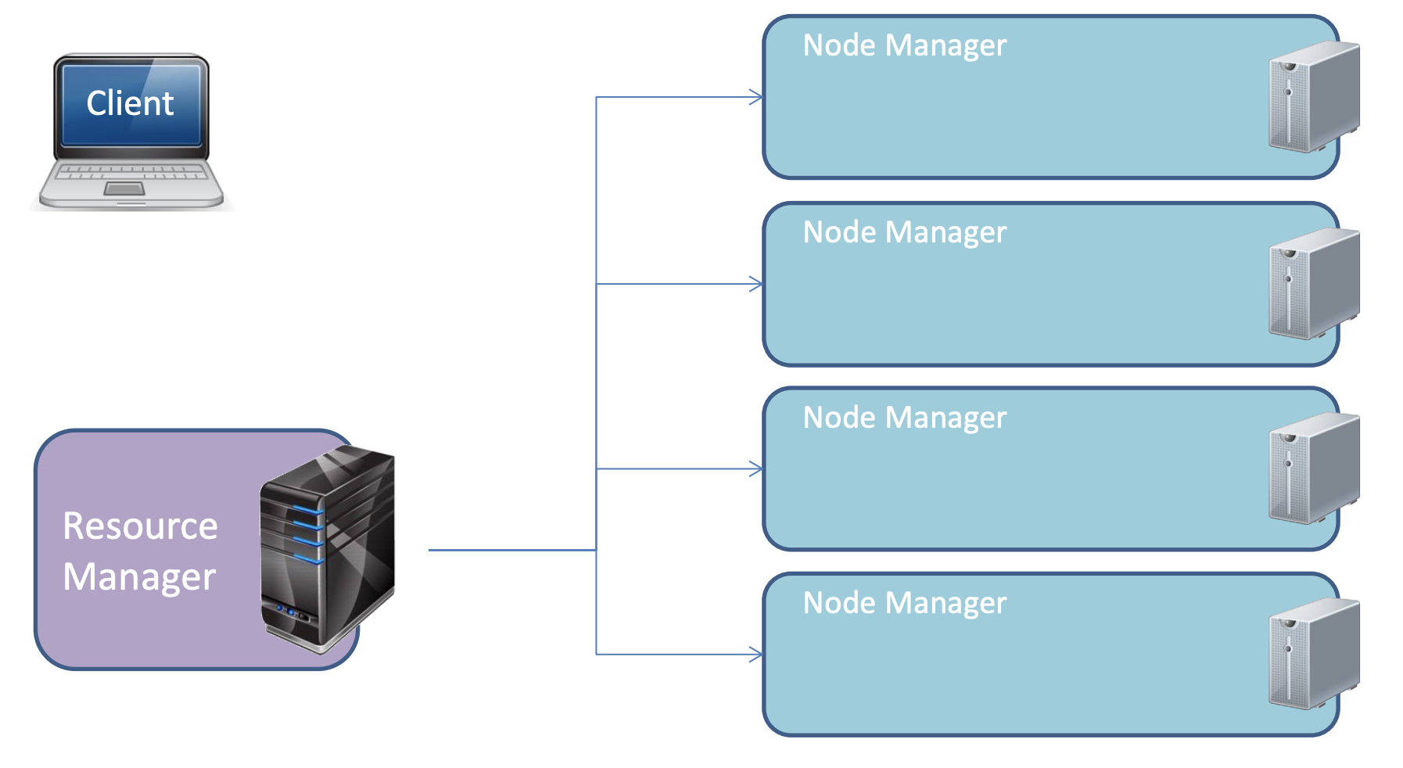
Hadoop. YARN. Workflow

Slide 25
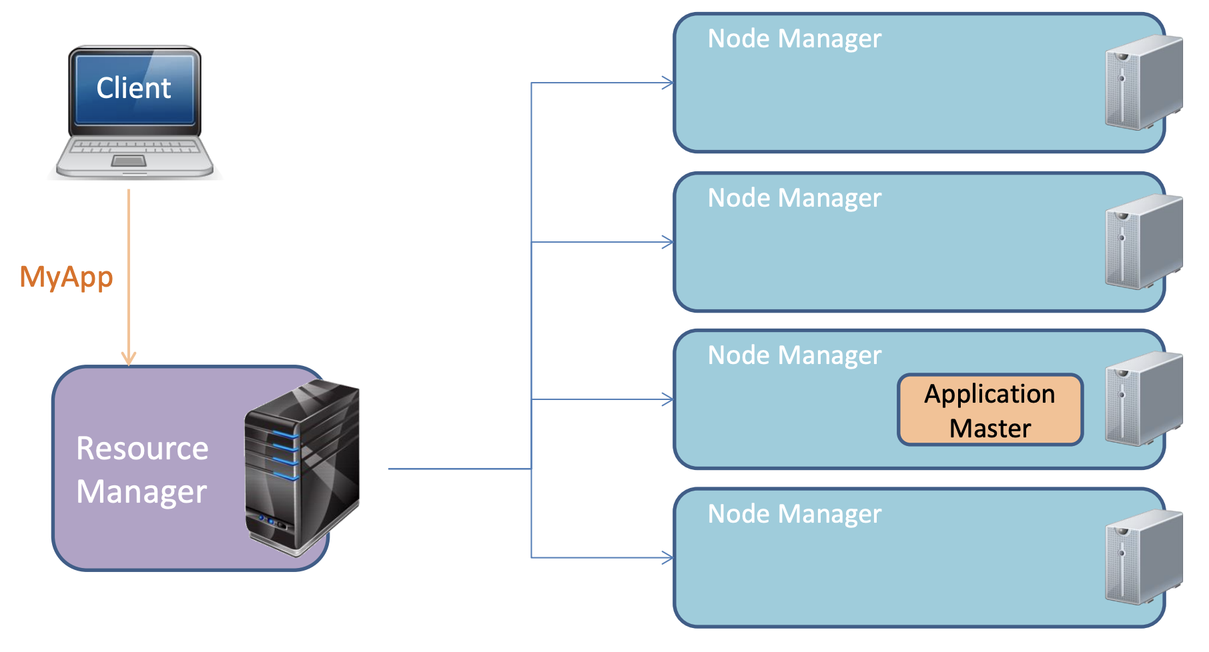
Hadoop. YARN. Workflow

Slide 26
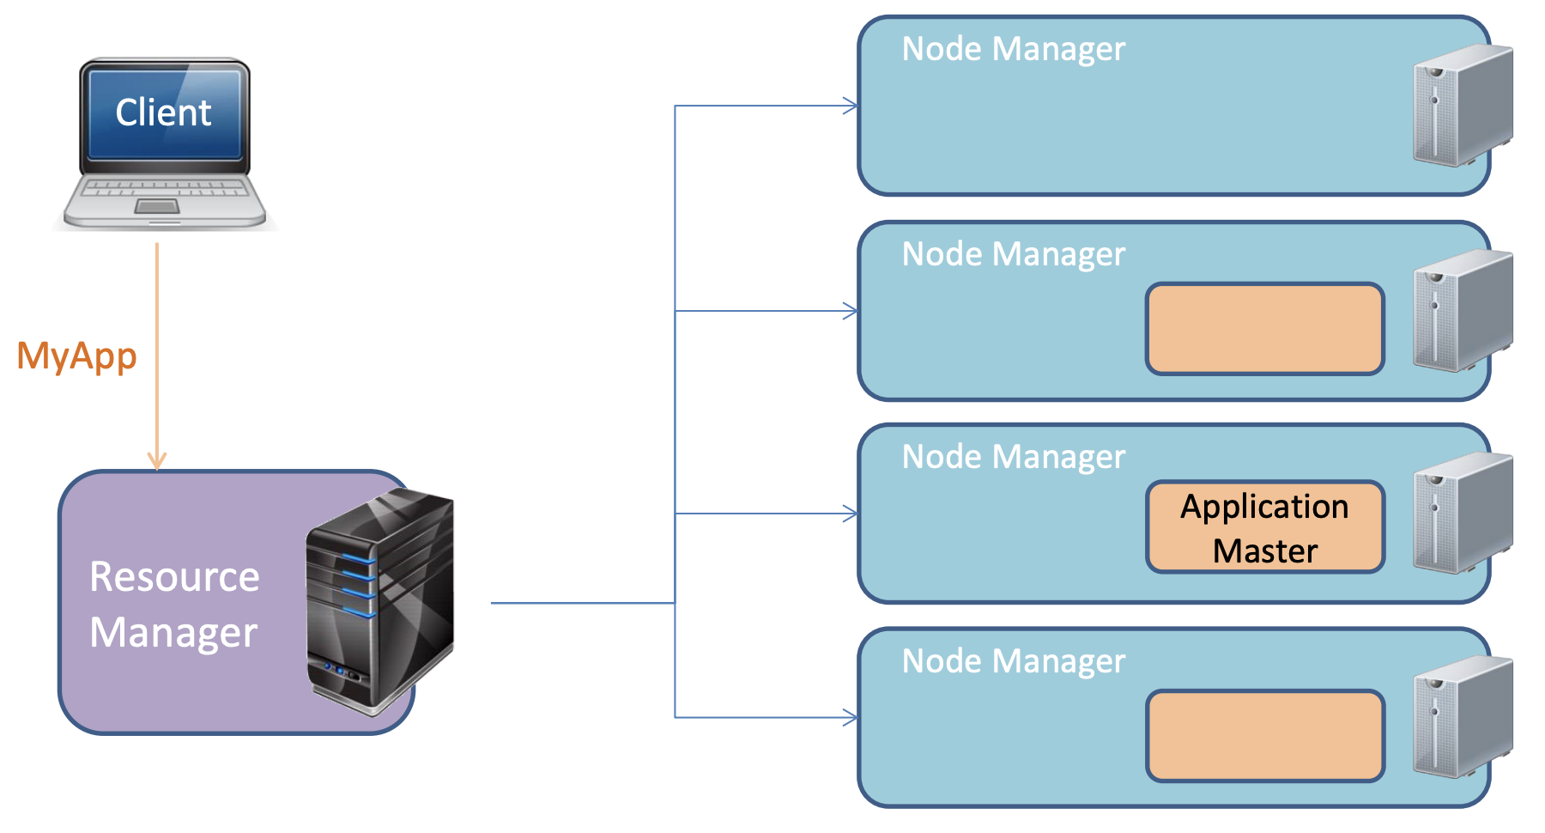
Hadoop. YARN. Workflow

Slide 27
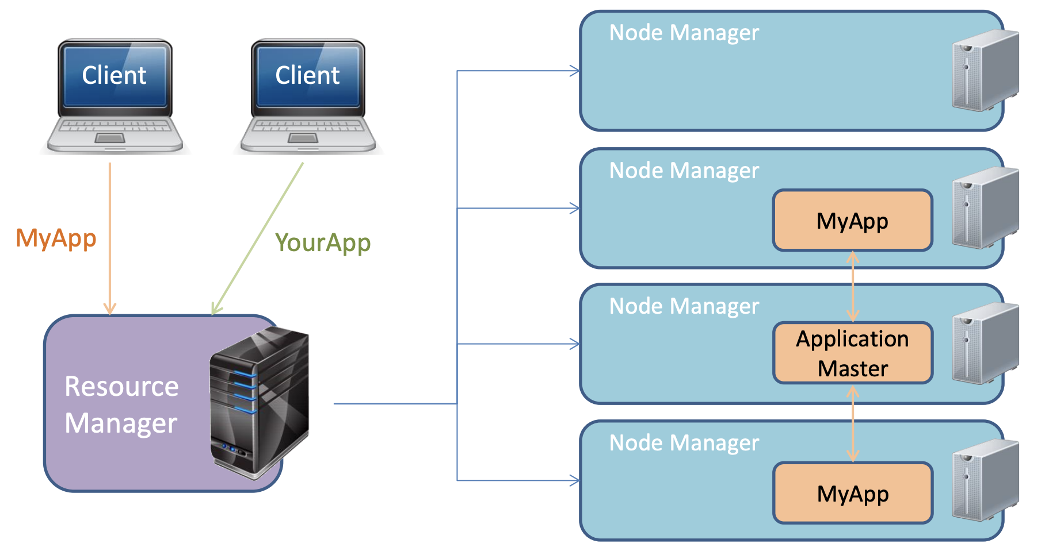
Hadoop. YARN. Workflow

Slide 28
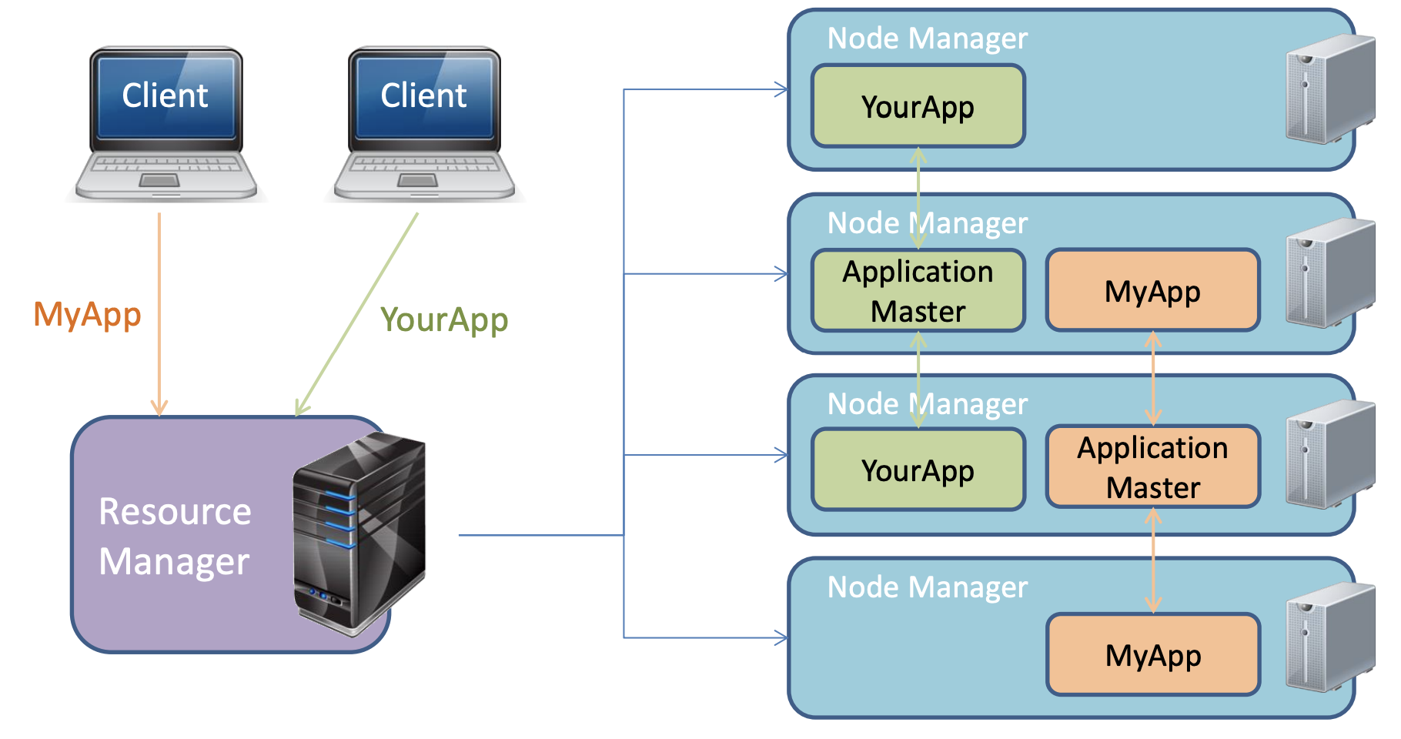
Hadoop. YARN. Workflow

Slide 29
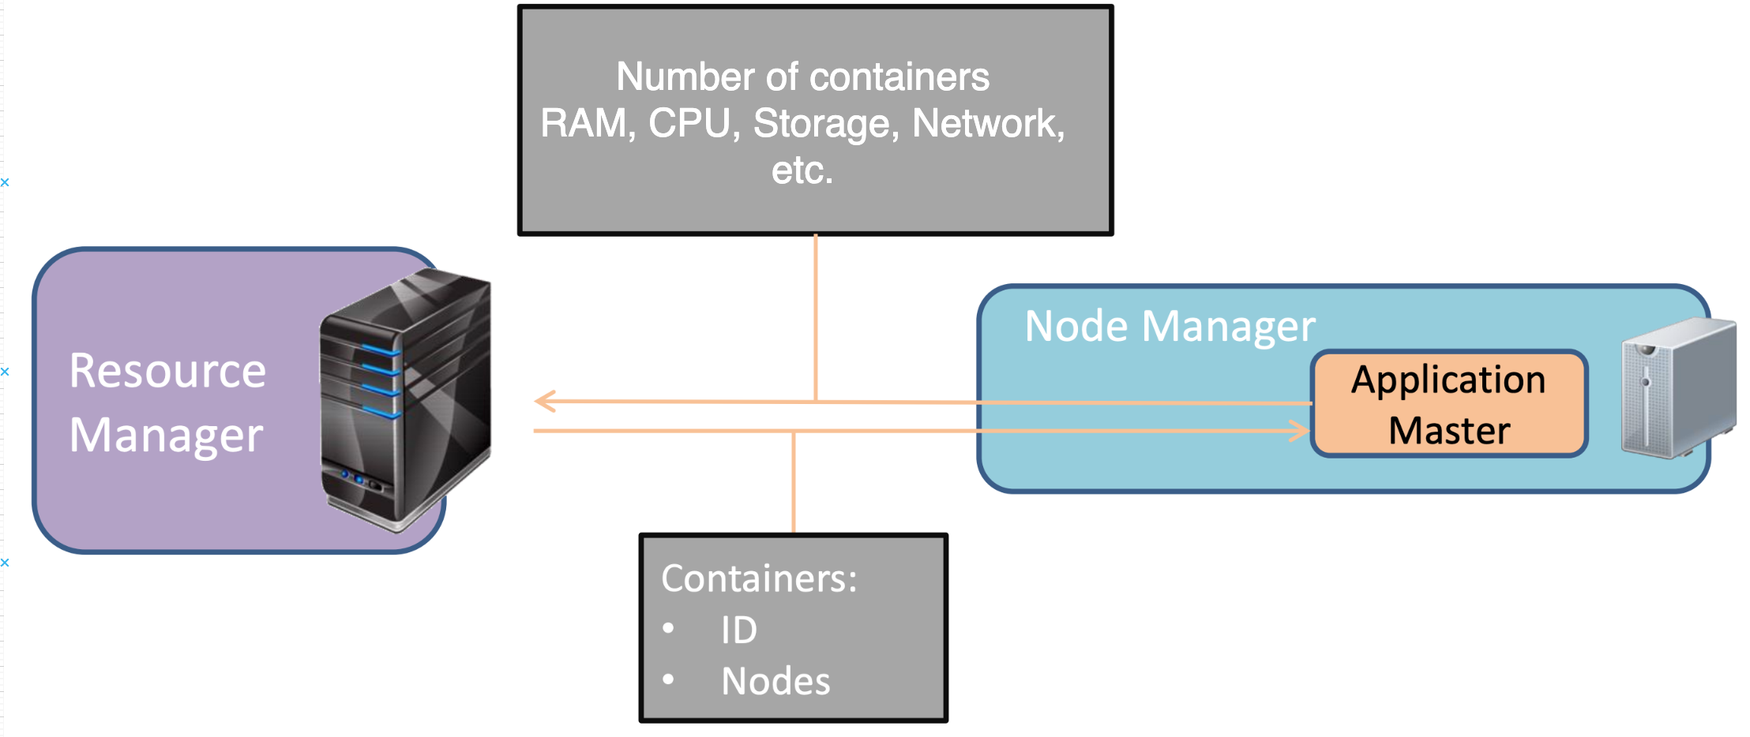
Hadoop. YARN. Resource allocation

Slide 30
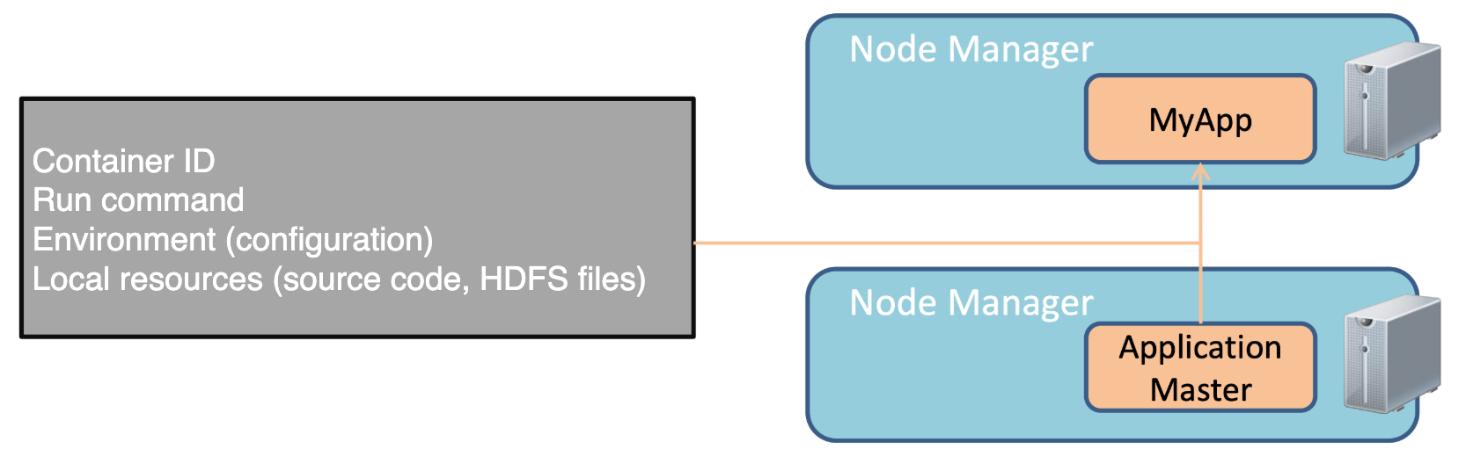
Hadoop. YARN. Container allocation

Slide 31
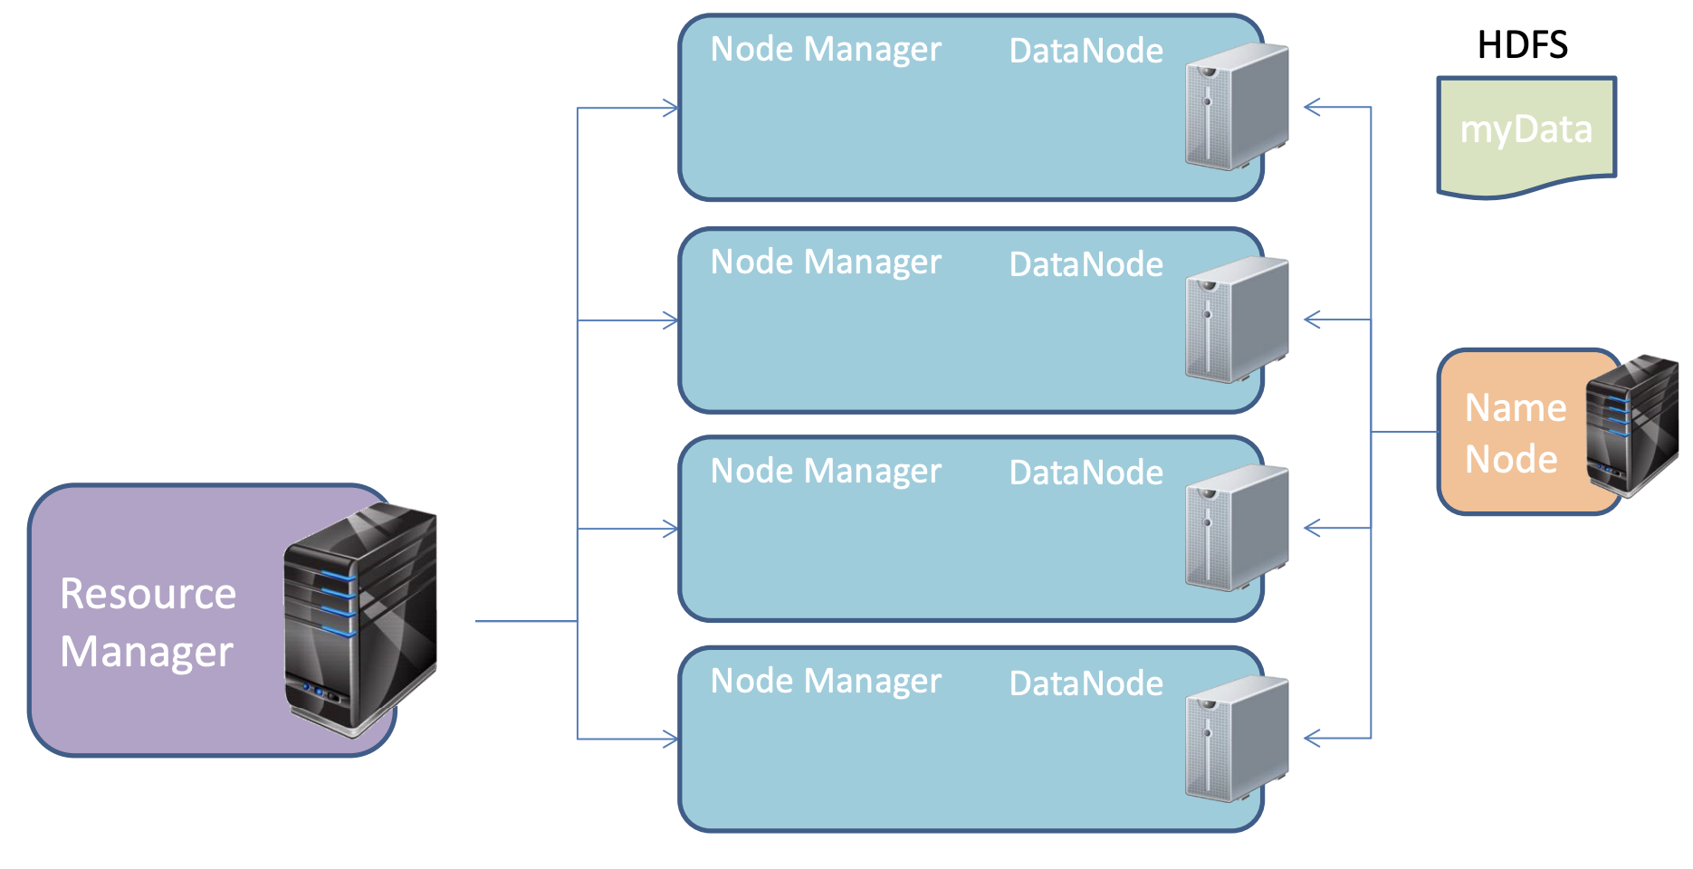
Hadoop. YARN. MapReduce

Slide 32
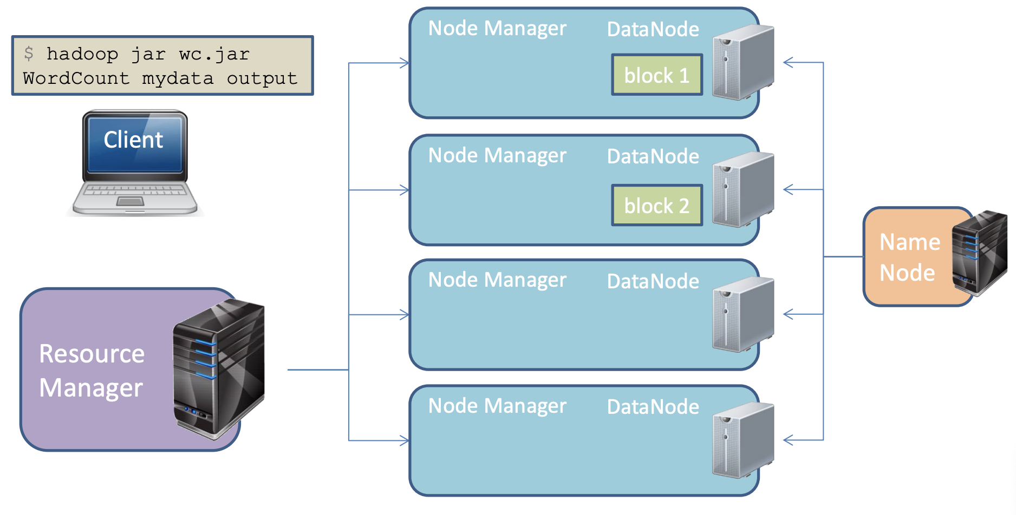
Hadoop. YARN. MapReduce

Slide 33
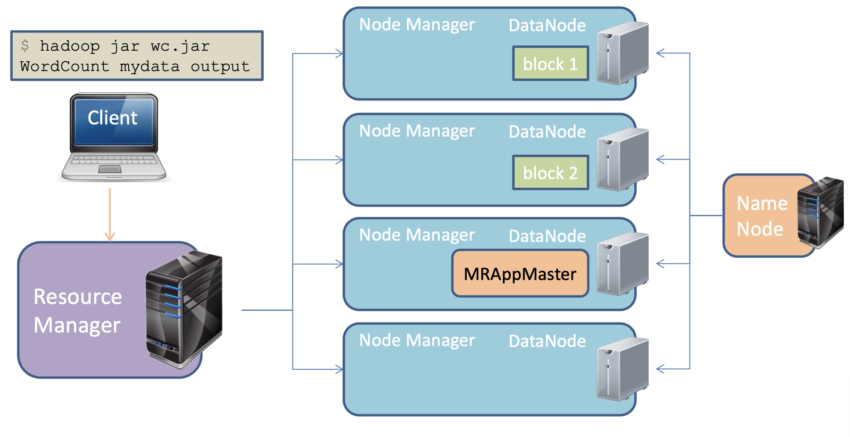
Hadoop. YARN. MapReduce

Slide 34
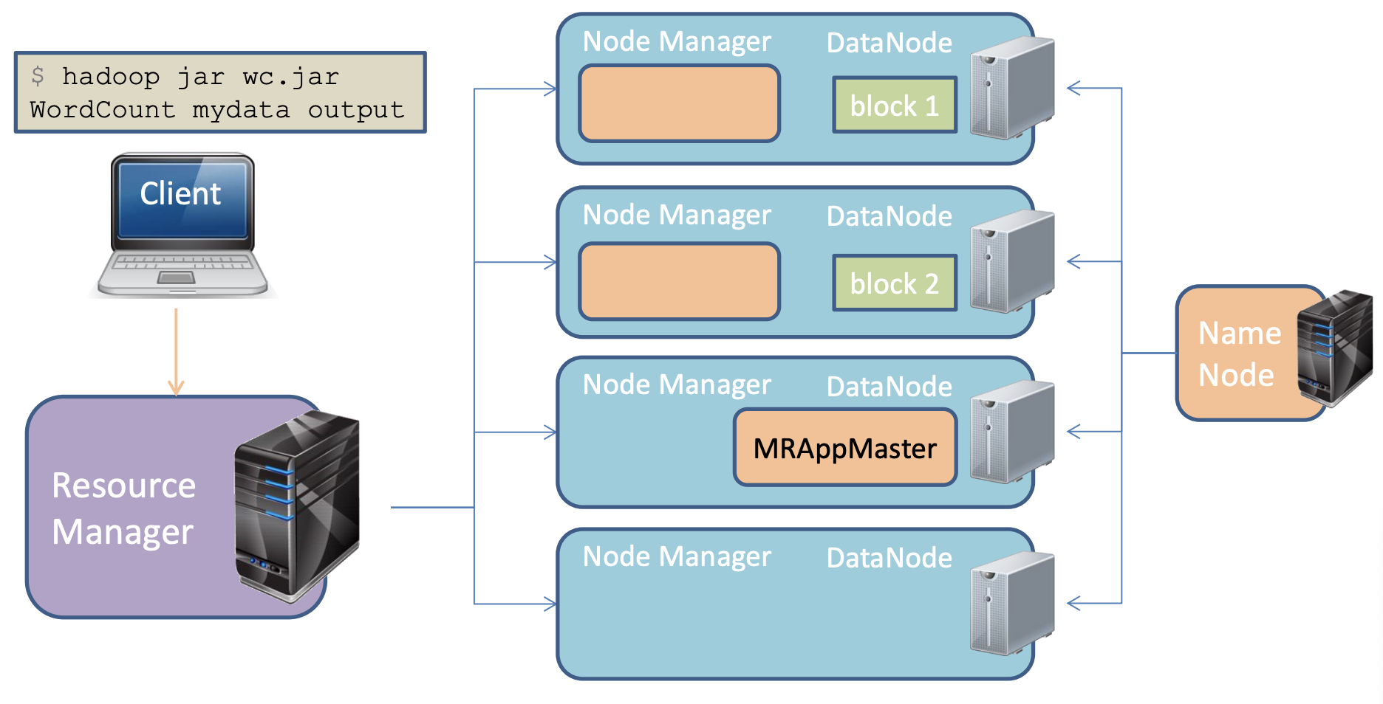
Hadoop. YARN. MapReduce

Slide 35
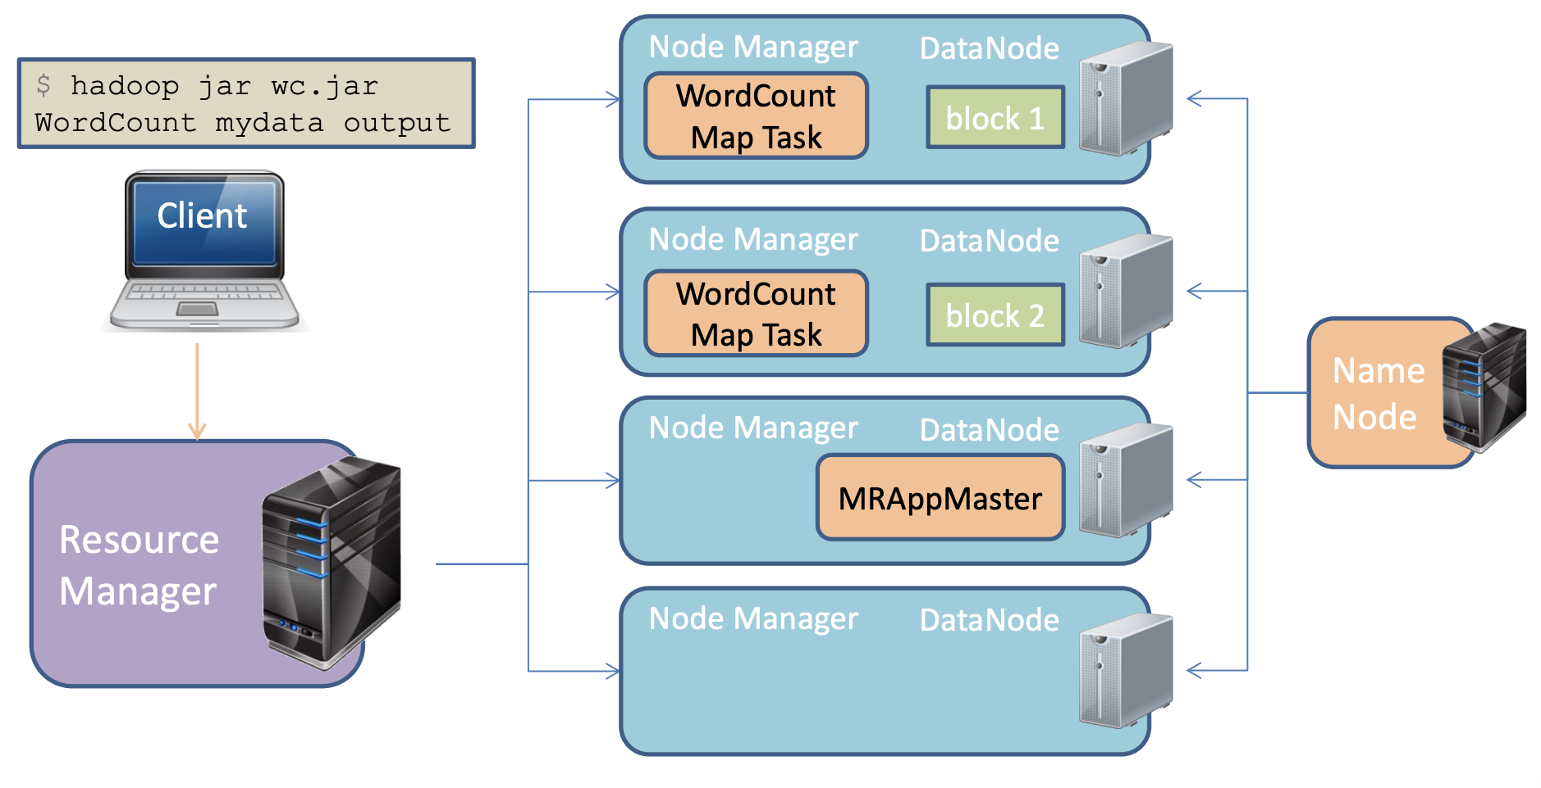
Hadoop. YARN. MapReduce

Slide 36
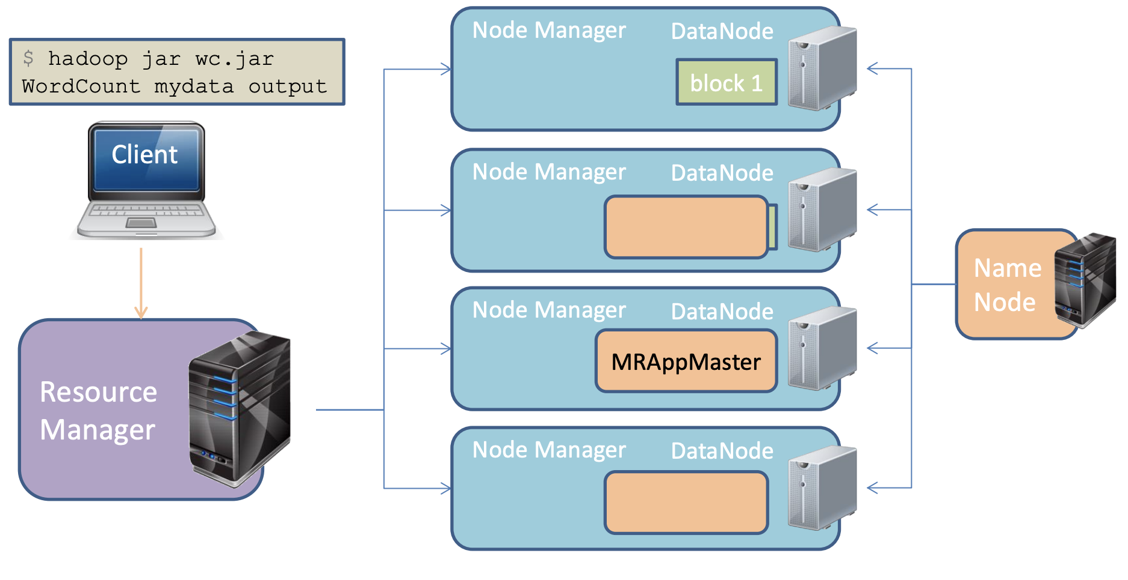
Hadoop. YARN. MapReduce

Slide 37
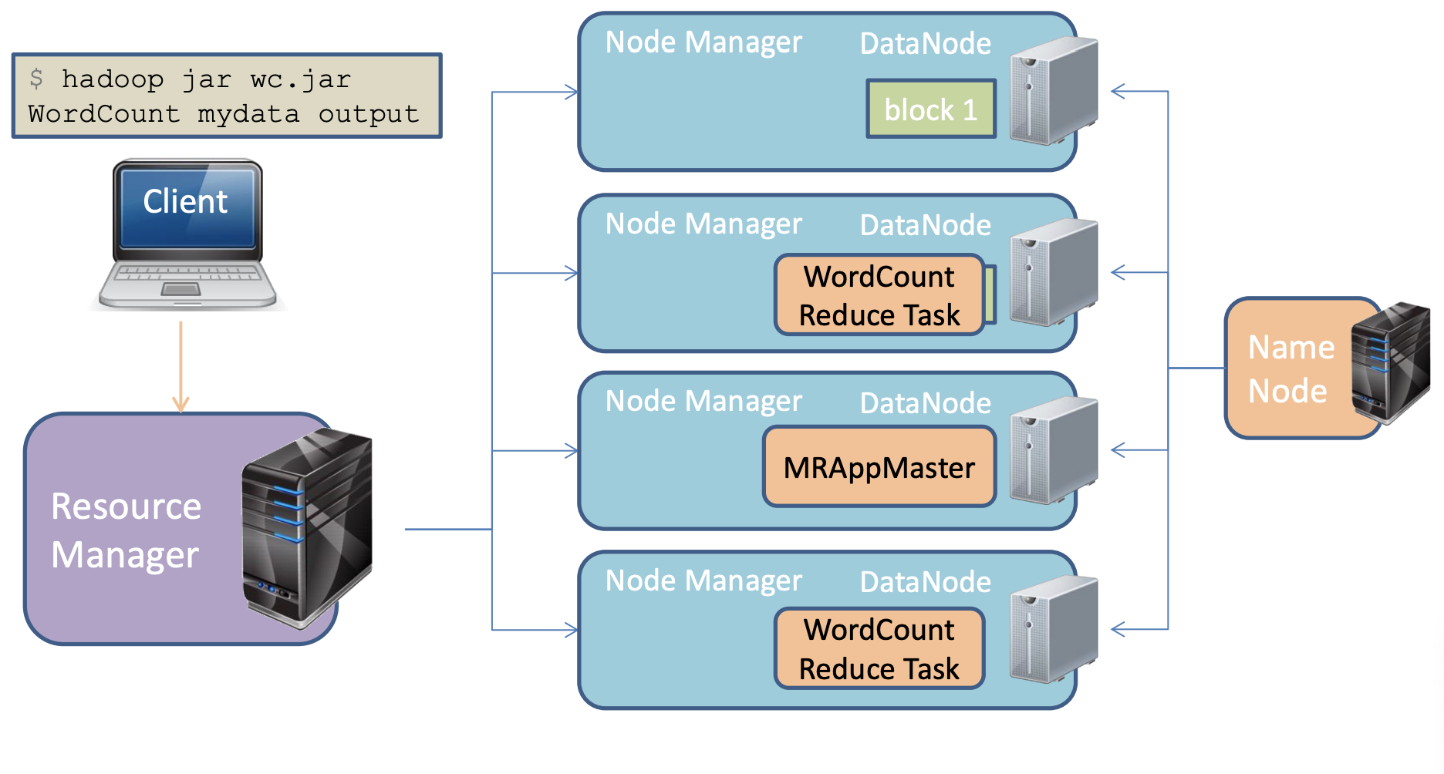
Hadoop. YARN. MapReduce

Slide 38
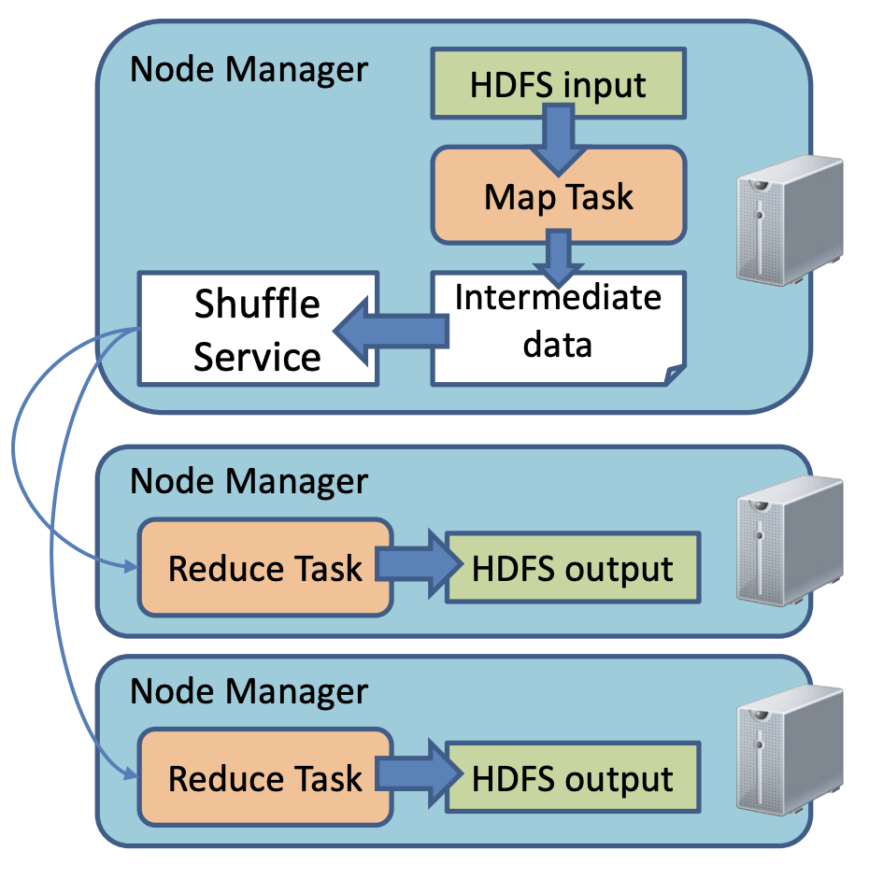
Hadoop. YARN. MapReduce. Shuffle Service
A separate NodeManager process on the node that remains available even if the Mapper has finished execution
Without the shuffle service, local Map output files could be unavailable —> the Reduce task will fail.
Responsibilities of the shuffle service:
Access authorization
Maintaining a cache on the local disk
Streaming large files

Slide 39
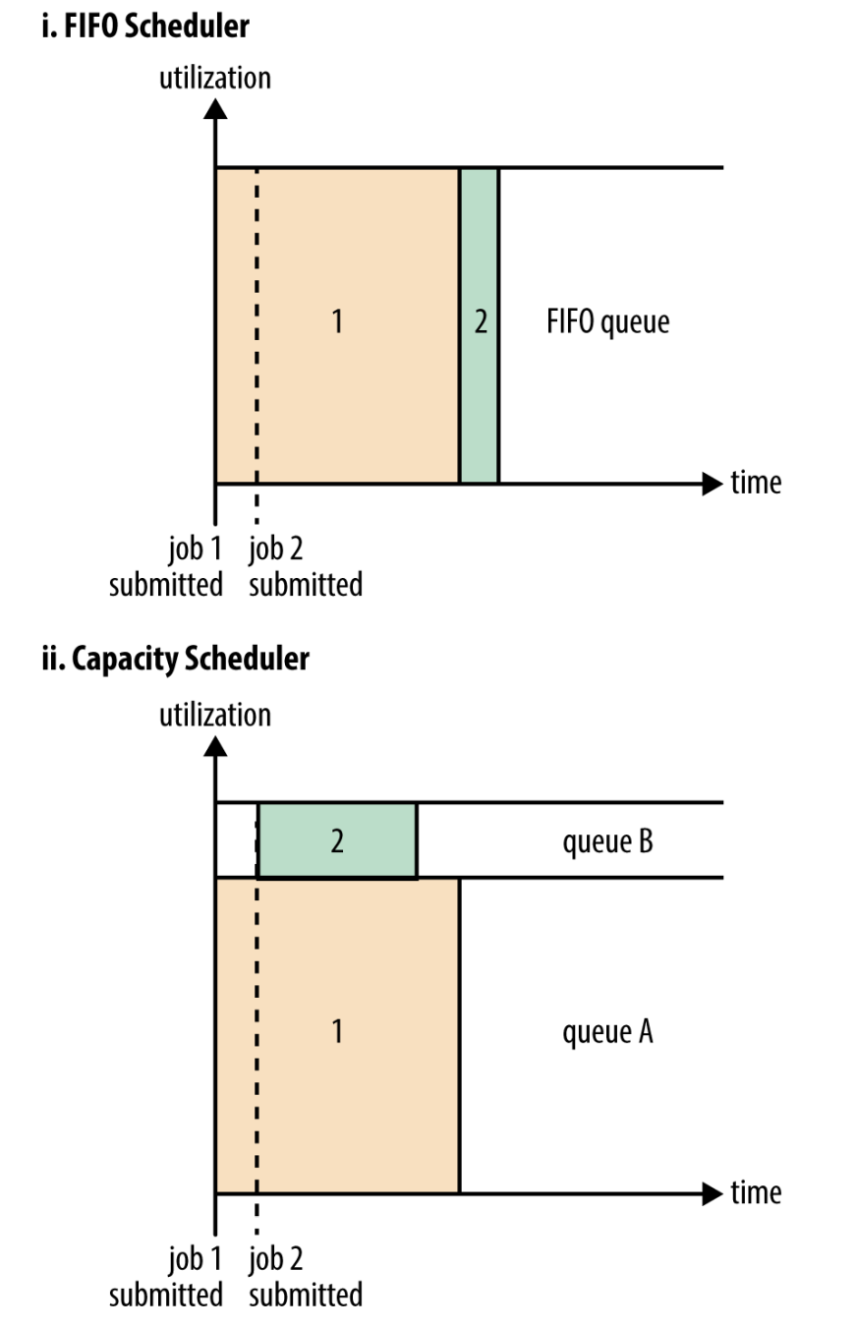
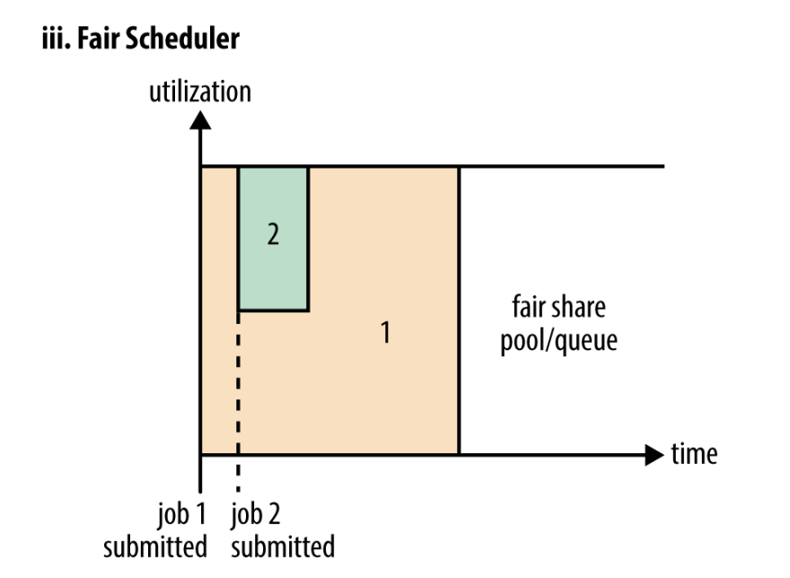
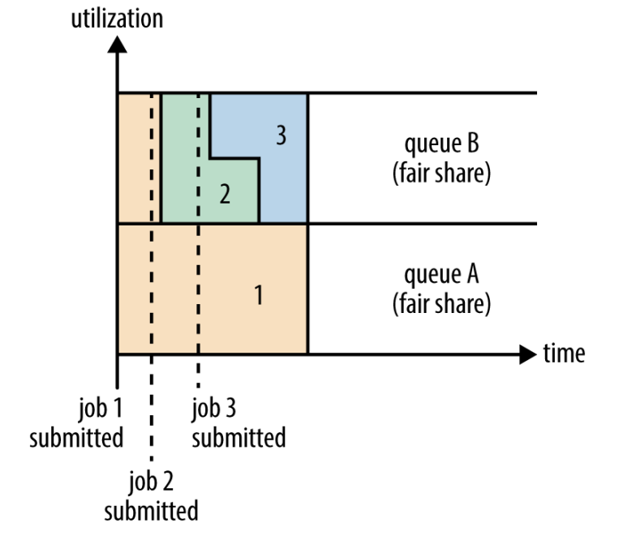
Hadoop. YARN. Task Scheduler

Slide 40
Hadoop. YARN. Memory management
Resource Manager allocates memory:
Minimum: yarn.scheduler.minimum-allocation-mb (1024 MB)
Maximum: yarn.scheduler.maximum-allocation-mb (8192 MB)
The allocated amount has to be a multiple of the minimum amount
Each Node Manager has a memory limit:
yarn.nodemanager.resource.memory-mb (8192 MB)
The sum of all containers cannot exceed this limit
NodeManager does not create a container if there is insufficient memory

Slide 41
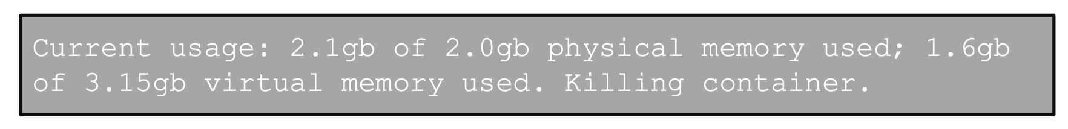
Hadoop. YARN. Memory management
Container sizes for Map and Reduce tasks:
mapreduce.map.memory.mb = 1536
mapreduce.reduce.memory.mb = 3072
JVM Heap sizes:
mapreduce.map.java.opts = -Xmx1024m
mapreduce.reduce.java.opts = -Xmx2560m
Virtual memory size is set as a ratio of physical memory:
yarn.nodemanager.vmem-pmem-ratio = 2.1
If a Map or Reduce task exceeds the virtual or physical memory limit, the Node Manager kills the corresponding container:

Slide 42
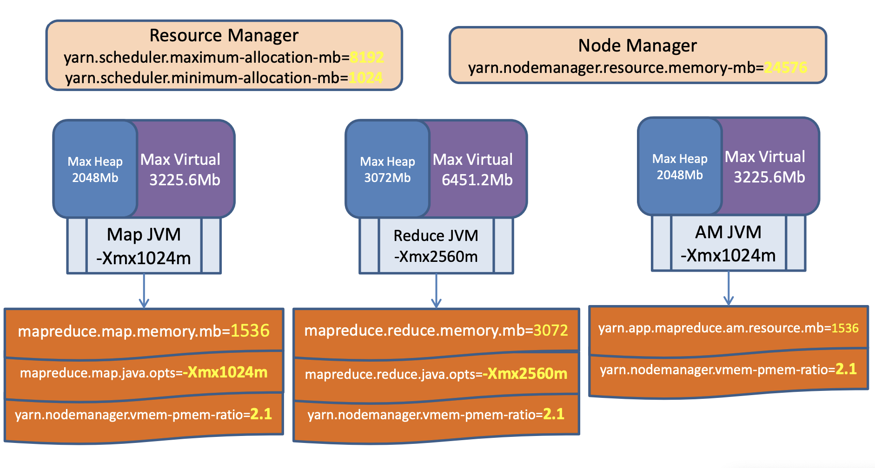
Hadoop. YARN. Memory management

Slide 43
Hadoop. YARN. Fault tolerance
Failures can occur at:
Container (Task)
Application Manager (MRAppMaster)
Node Manager
Resource Manager

Slide 44
Hadoop. YARN. Container failure
Possible events:
Exception
JVM crash / server shutdown
Process hang
Handling:
MRAppMaster restarts the task
Number of retries is controlled by:
mapreduce.map.maxattempts = 4
mapreduce.reduce.maxattempts = 4

Slide 45
Hadoop. YARN. Application Manager failure
AM finishes with an error
Signals from AM may not reach RM
Resource Manager restarts the AM
yarn.resourcemanager.am.max-retries = 2
MRAppMaster can recover task state before restart:
yarn.app.mapreduce.am.job.recovery.enable = true

Slide 46
Hadoop. YARN. Node Manager failure
If Node Manager (NM) fails:
NM stops sending signals to RM
Containers on NM stop sending signals to AM
RM removes NM from active nodes if no heartbeat for 10 minutes:
yarn.resourcemanager.nm.liveness-monitor.expiry-interval-ms
MRAppMaster blacklists NM if 3 container failures occur:
mapreduce.job.maxtaskfailures.per.tracker

Slide 47
Hadoop. YARN. Resource Manager failure
No tasks or applications can run
Leads to cluster downtime
RM High Availability through ZooKeeper (ZooKeeper Failover Controller)

